Slide 1


Vehicle mounted image acquisition device for infrastructure asset management.
Group members
Jithin Rajan Varghese
Karan Patel
Manmohit Chugh
Parth Patel

Slide 2
Progress in this term
Initial Problem Statement
Many industries are developing and deploying computer vision to improve productivity. Our community partner leverages computer vision to understand infrastructure asset conditions using a vehicle mounted camera deployed with onboard processing, network connectivity and cloud storage. We want to improve upon existing datasets the effectiveness of ML (Machine Learning) algorithms that implement computer vision and further increase accuracy in identifying significant features (potholes, signs, etc.). We want to understand the best combination of hardware for vehicle mounted data collection. We also want to know how adding other sensors (LiDAR, ground penetrating radar, profilometers, ultrasonic transceivers and stereo photography.) improves understanding of infrastructure conditions.
Narrowed Scope Problem Statement
To create a method to identify sidewalk and retaining wall defects and report them after validation of the same

Slide 3
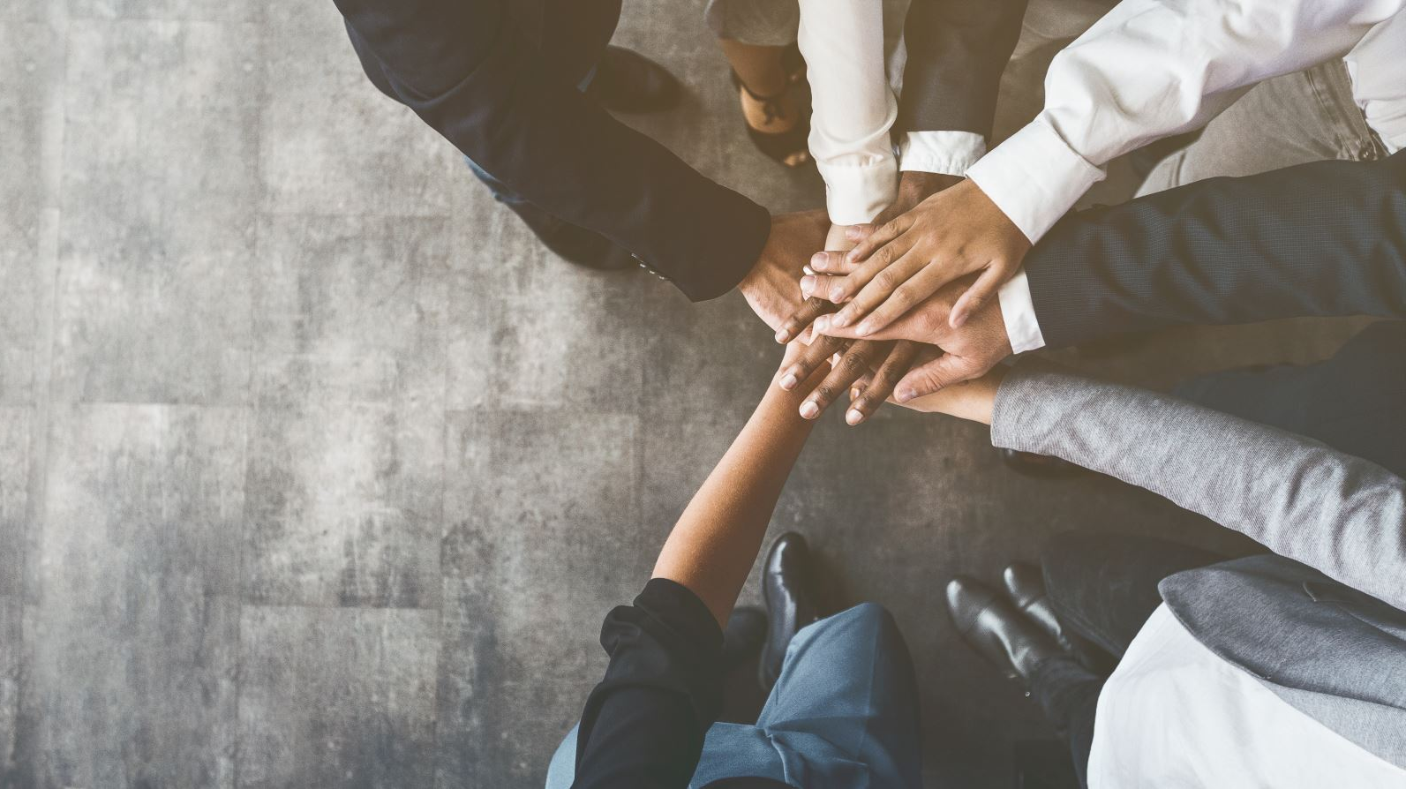
Discussion with Community partner and key stakeholders
Initial discussions were focused on narrowing of scope
We also had instances of scheduling conflict with community partner
Once scope was narrowed, we had a discussion with community partner on potential solutions
Last discussion on solution took place with professors, IRIS R&D and us and we proposed a solution(27th July 2022).
The solution was given greenlight and go ahead from both professors and IRIS

Slide 4
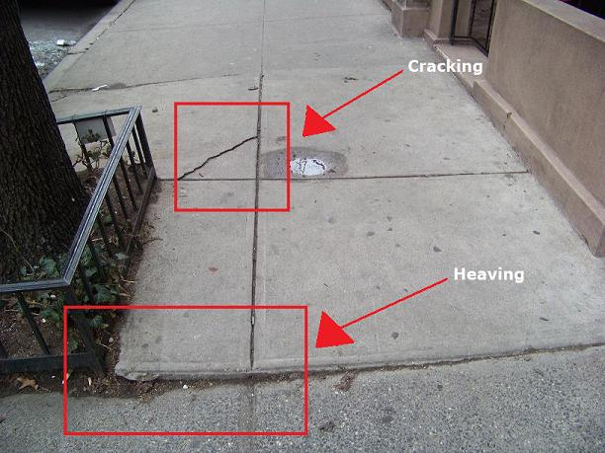
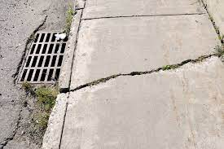
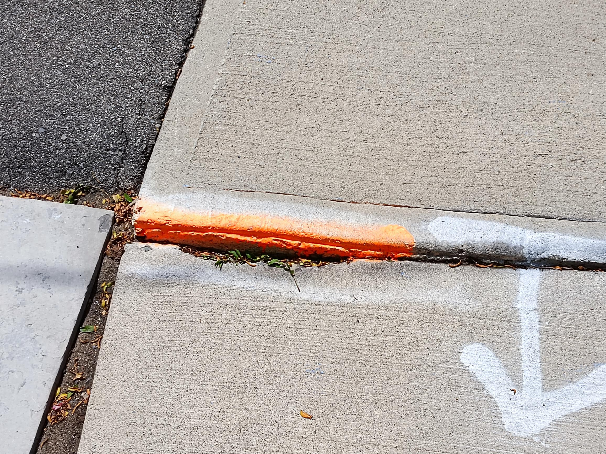
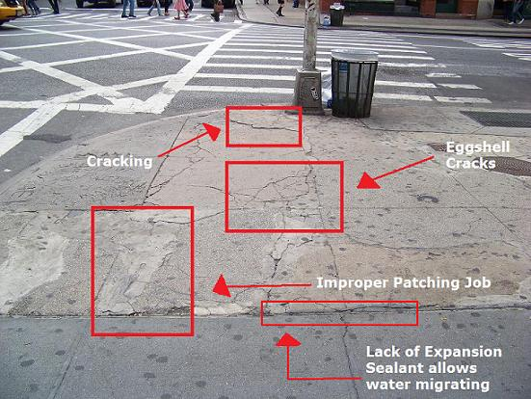
Example of damaged sidewalk

Slide 5
Proposed Solution for the problem statement post discussion
Major Challenges to creating a solution were
No available dataset for initial analysis
No labeled data
Cost and material constraints
GITHUB URL
Anyone can upload images with geo location
and interact email id
ML algorithm that analyses images based on available data
Proposed Solution
A POC with GitHub URL and ML algorithm working in the background.
The idea is to use people to collect nearly labelled data and then teach the algorithm based on such images
The model once sufficiently trained will be able to identify invalid cases with accuracy and start to function without human oversight
The logic is to develop the dataset along with training the model
Business Logic for Solution
Every valid image get 1$ as payment to incentivize participation
Payment made every month after images are validated
Further expansion of idea can include mobile app for same.
Challenges to the Solution
Every image must be valid i.e., no duplicates (unless dated far apart).
Use of similar location images to verify and validate a sidewalk defect

Slide 6
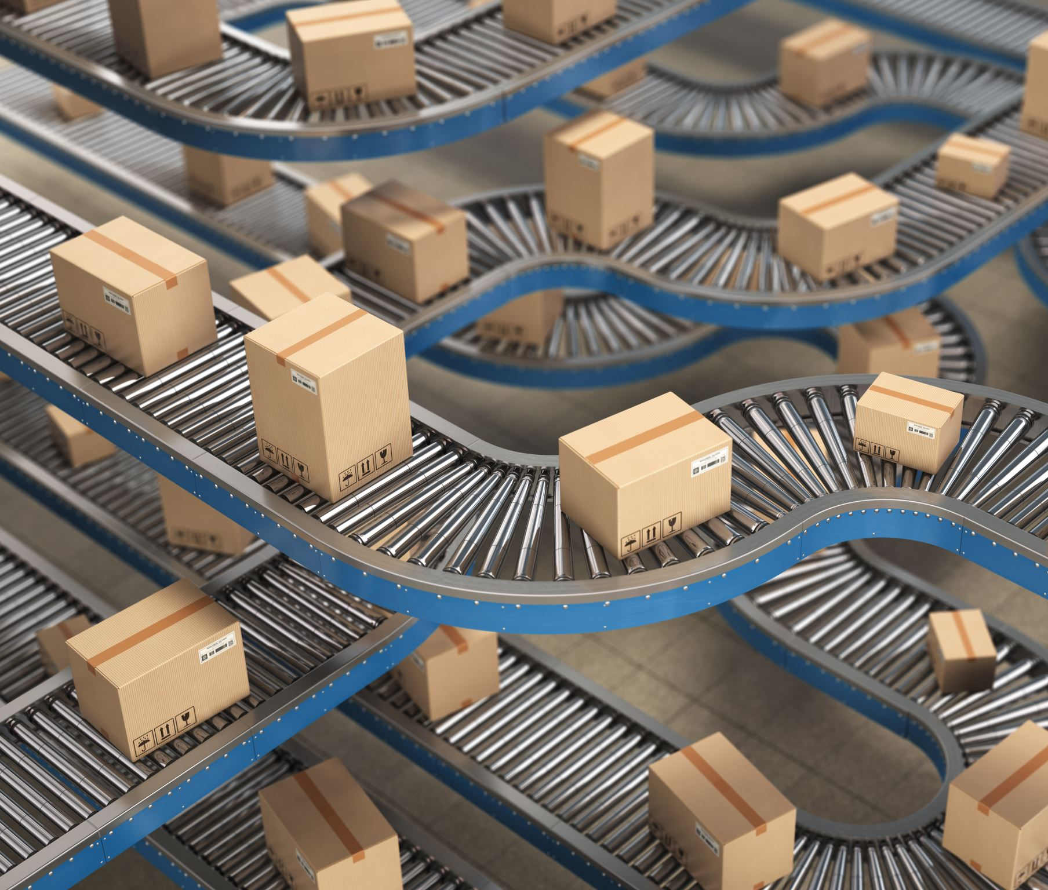
Expected deliverable for Project Part 2
To develop a proof of concept of the solution that can scale.
To analyze the challenges of the algorithm and develop the case further
To create a better business case and payment system

Slide 7
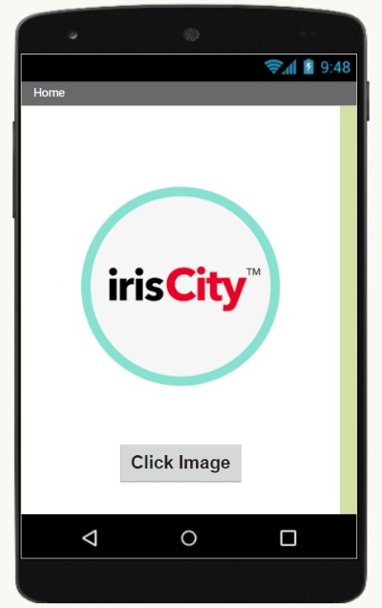
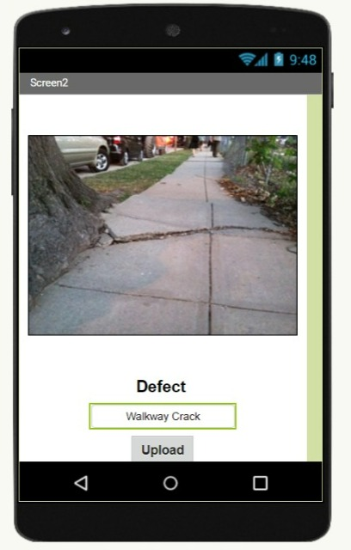
Future Goals

Slide 8
Required skillset
We are searching for some open-source software and learning Android studio for app development.
Also planning to get access with some image processing APIs for detection road features.

Slide 9
Various Algorithms available for defect identification
CNN's are the go-to for identifying defects, multiple CNN's are available for identifying the defect such as
VGG-16
ResNet
AlphaNet
GoogleNet
More Indepth study needs to be done in order to identify the best algorithm to be used for defect detection in sidewalks
Some important aspects to be considered for use of above said algorithms are
Training time
Prediction time
And the amount of transfer learning to be applied
For example, VGG-16 is very good network for defect identification but must be trained on a machine with enough compute
Another factor is the preprocessing of data which can potentially reduce the time required for the training.

Slide 10
Thank You !
Any Questions?

